Slide 1
Selected questions that are on new Physics IB syllabus
From HL May 08 TZ2
and
Grade Gorilla

Slide 2
Elephant lifetime

Slide 3
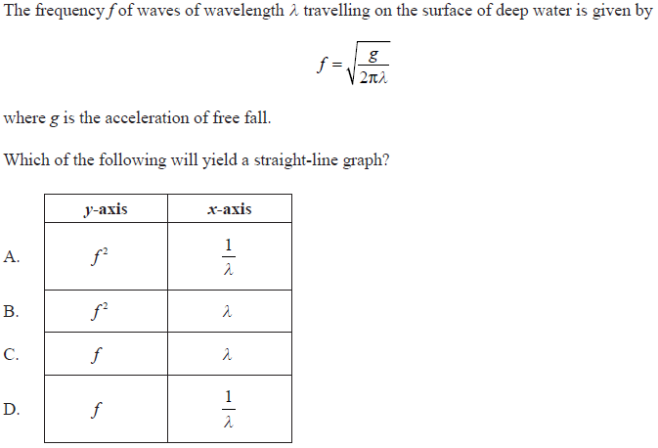
Straight line plot

Slide 4
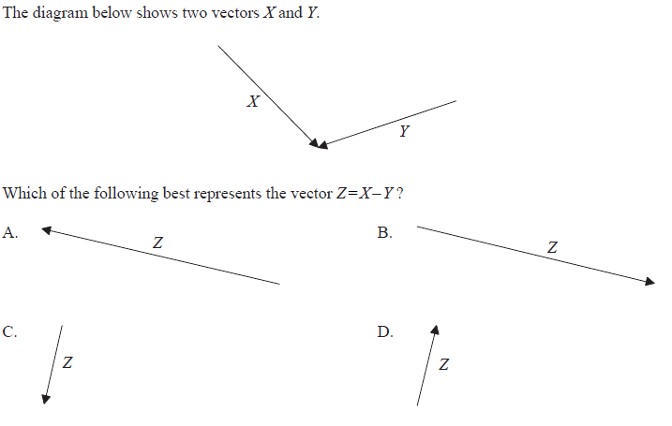
Vector subtraction

Slide 5
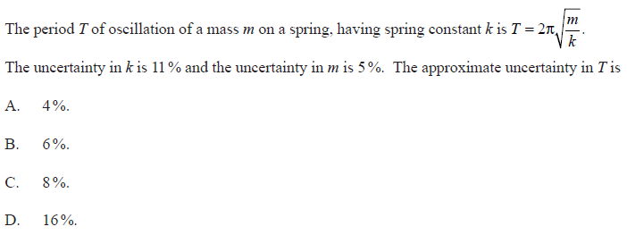
Combining percentage uncertainty

Slide 6
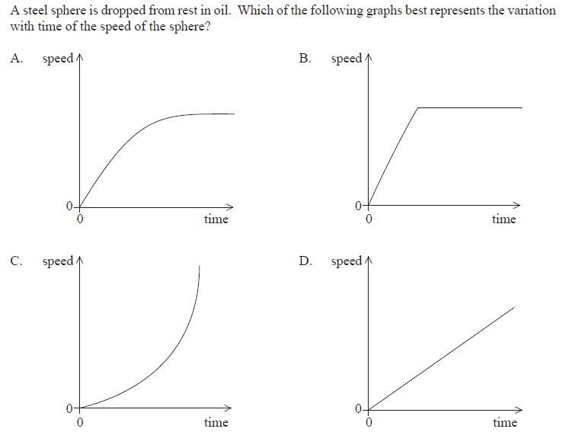
Falling in viscous fluid

Slide 7
Efficiency

Slide 8
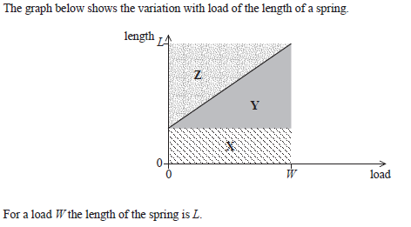
Spring stretch

Slide 9
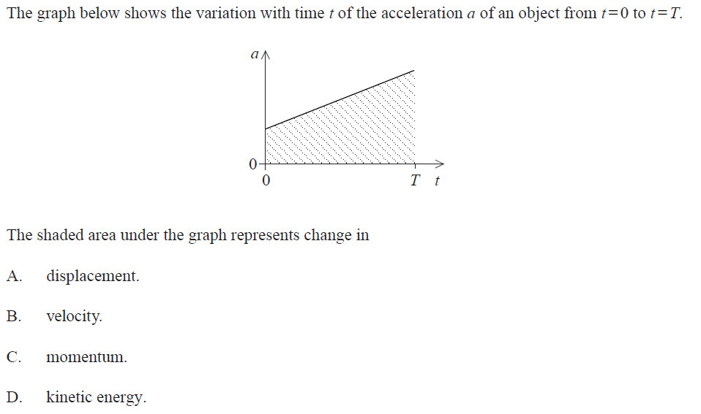
Acceleration 1

Slide 10
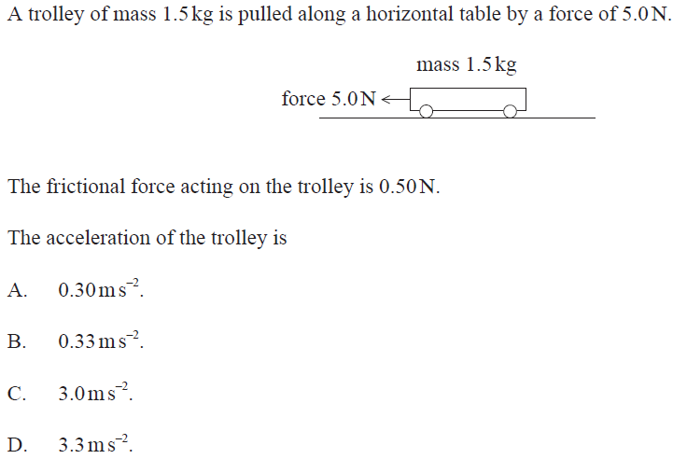
Acceleration 2

Slide 11
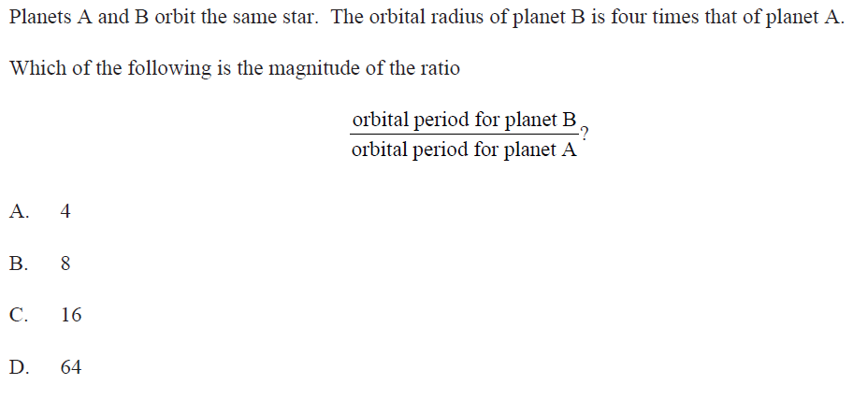
Circular motion

Slide 12
Escape velocity

Slide 13
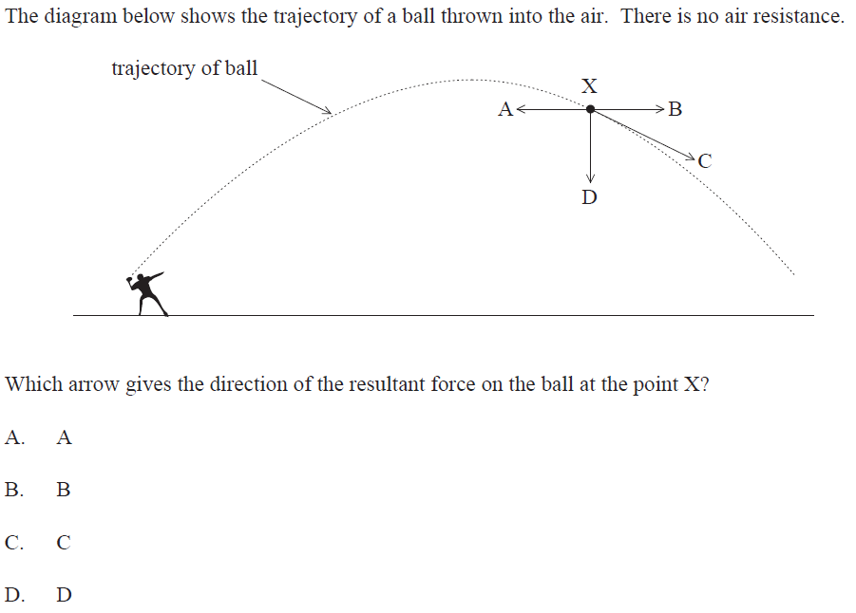
Forces in Fields

Slide 14
Gas leak

Slide 15
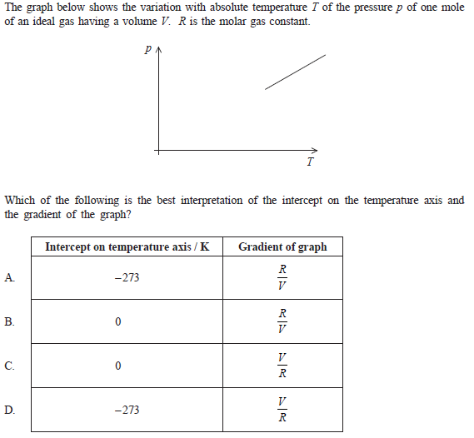
Ideal gas

Slide 16
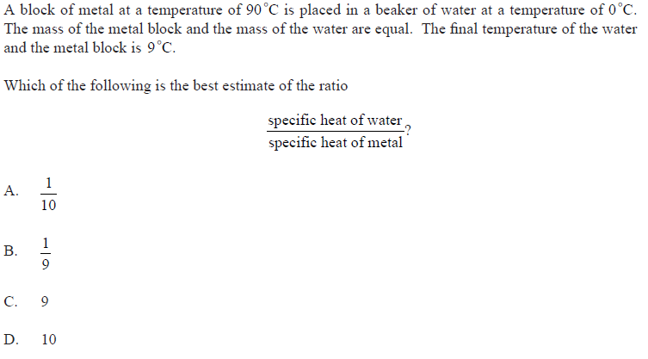
Specific heat (capacity)

Slide 17
Entropy

Slide 18
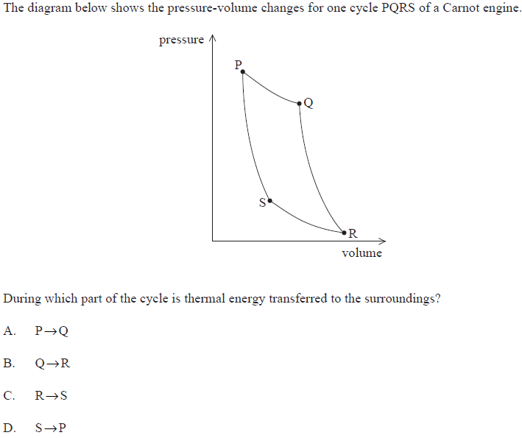
Heat Engine

Slide 19
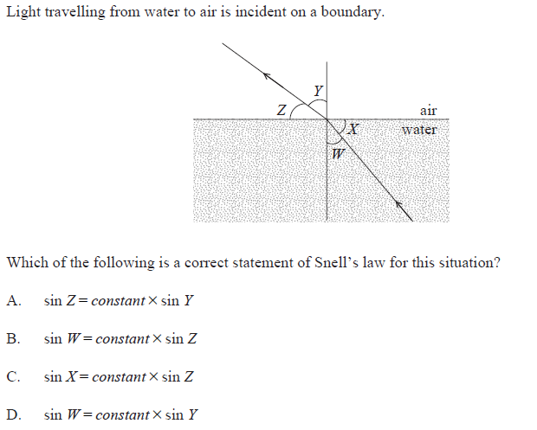
Snell’s law

Slide 20
Standing wave

Slide 21
Standing wave 2

Slide 22
Interference

Slide 23
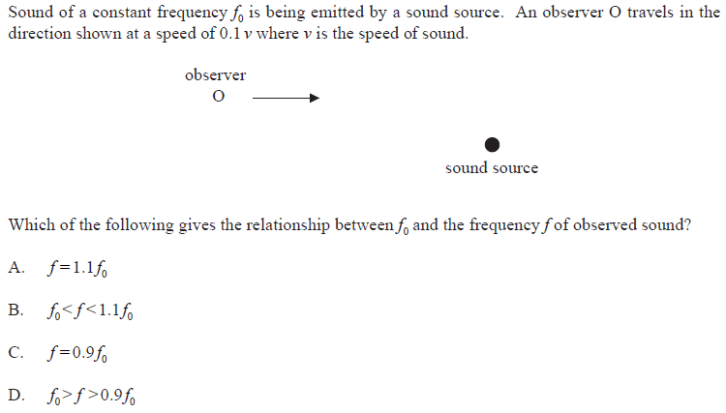
Doppler shift

Slide 24
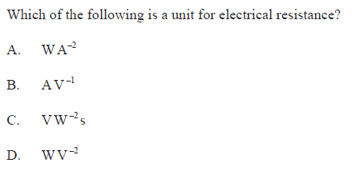
Units of resistance

Slide 25
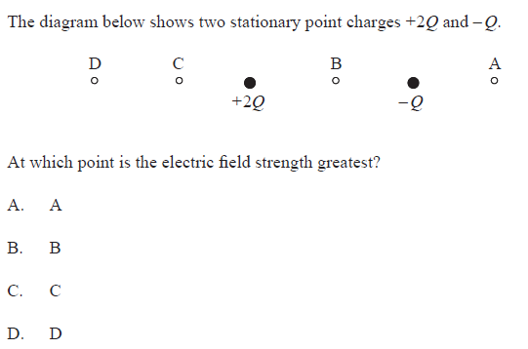
Field due to point charges

Slide 26
Field due to current

Slide 27
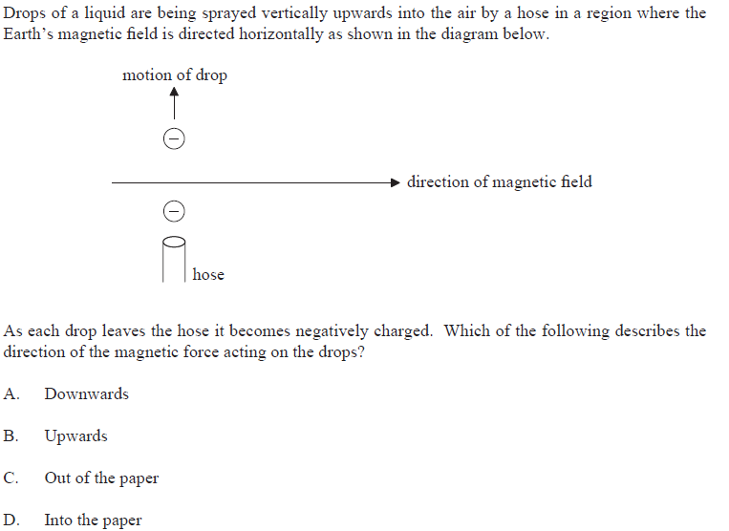
Field effects

Slide 28
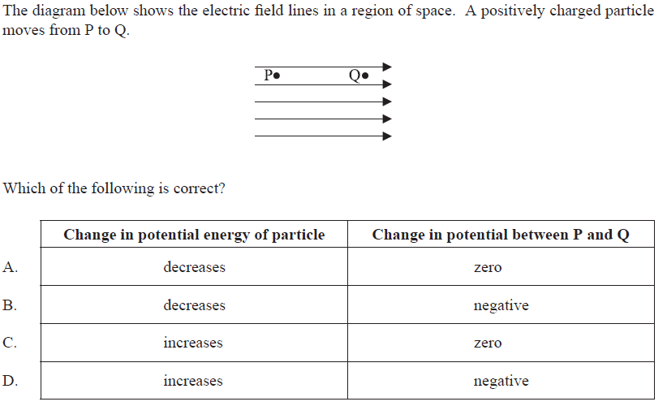
Field effects 2

Slide 29
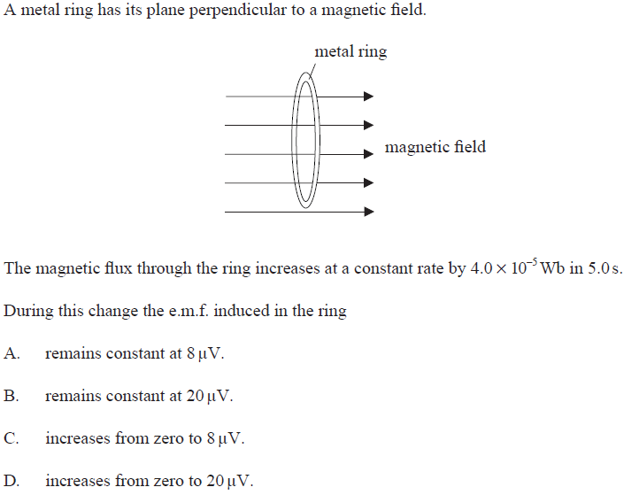
Induction

Slide 30
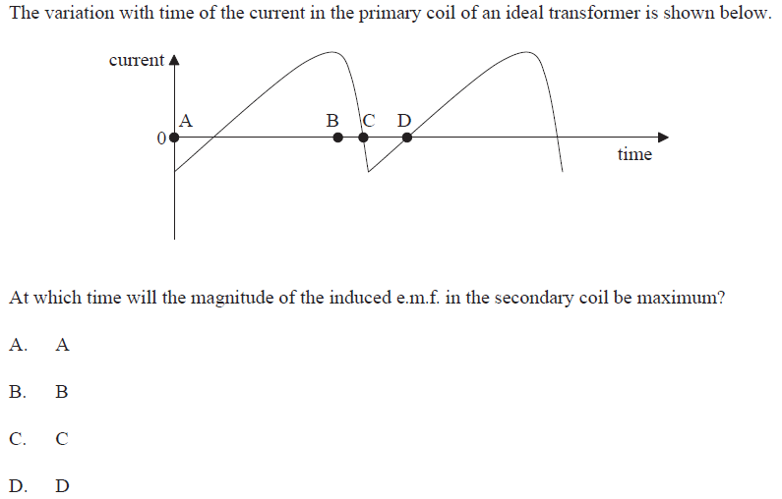
Induction 2

Slide 31
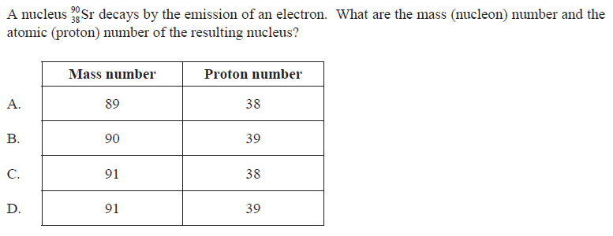
Beta minus decay

Slide 32
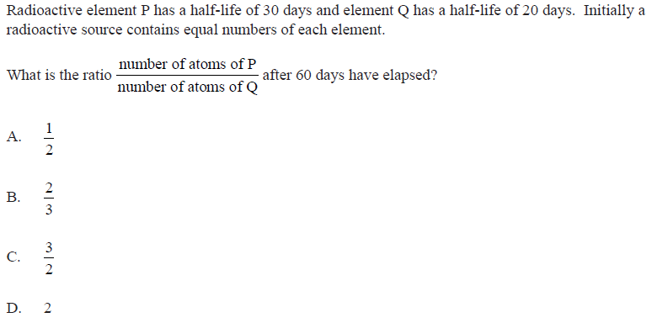
Decay rates

Slide 33
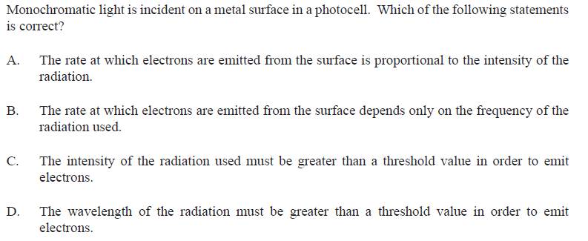
Photocell

Slide 34
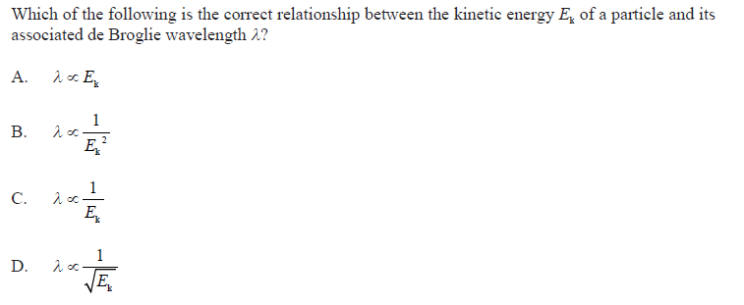
de Broglie wavelength

Slide 35
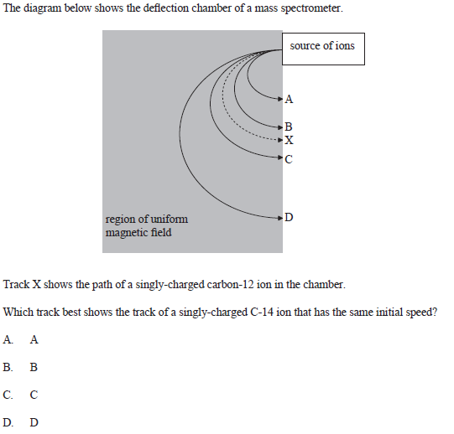
Mass spectrometer

Slide 36
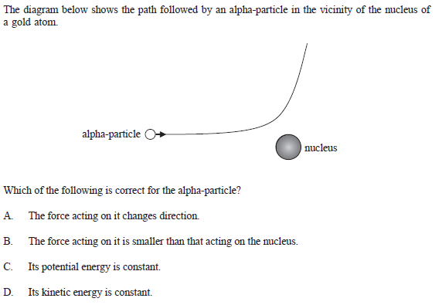
Alpha scattering

Slide 37
Fossil fuels
Which of these answers correctly describes the uses and properties of the 3 fossil fuels?
 | Most used worldwide in electricity generation | Highest efficiency in a power station
A. | gas | oil
B. | oil | coal
C. | coal | gas
D. | oil | oil
http://gradegorilla.com/IBclimate/climate1.php

Slide 38
Power of waves
A sea wave of length l, amplitude A and velocity v produces a maximum power output of P. if the wave increase in strength to have a velocity of 3v, amplitude of 4A, then the power for an identical length will be
A. 7P
B. 12P
C. 36P
D. 48P
http://gradegorilla.com/IBclimate/climate1.php

Slide 39
MeVc⁻²
When using the formula E=mc² it is common to use units of MeV c⁻². This is a unit of
A. mass
B. energy
C. velocity
D. power
http://gradegorilla.com/IBclimate/climate1.php

Slide 40
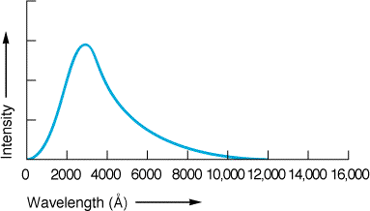
Black body radiation
Black body radiation is the name given to radiation emitted by a hot body. If the temperature of a body is doubled, how does this affect the power output and the peak wavelength?
 | Peak wavelength | Total power radiated
A. | increases | doubled
B. | increases | 16 times higher
C. | decreases | doubled
D. | decreases | 16 times higher
http://gradegorilla.com/IBclimate/climate1.php

Slide 41
Binary
The number 28 converted to binary is
A. 00111
B. 111
C. 11100
D. 10110
http://gradegorilla.com/IBclimate/climate1.php

Slide 42
CCD Resolution
Three distant stars appear close together in a line in the night's sky. They can just be resolved by a CCD if the light falls on a line of at least
A. 3 pixels length
B. 5 pixels length
C. 6 pixels length
D. 9 pixels length
http://gradegorilla.com/IBclimate/climate1.php

Slide 43
Magnification
A small rectangle measuring 1.5mm x 3mm is photographed using a digital camera. The image produced on the CCD measures 6mm x 12 mm. The magnification of the camera is therefore equal to
A. 4
B. 16
C. 0.25
D. 0.0625
http://gradegorilla.com/IBclimate/climate1.php

